Slide 1
Multiple Sclerosis
McKenzie Kargel

Slide 2
symptoms
Symptoms | Area of the Brain Related to Symptoms
Pins and needles in hands and feet | Parietal
Tired and weak | Pineal gland
Depression | Amygdala
Bad vision | Occipital lobe
Unsteadiness | cerebellum
Symptoms come and go

Slide 3
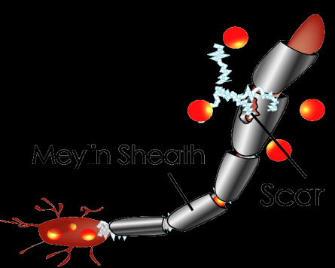
MS is caused by damage to the myelin sheath around the axons of neurons
When the myelin sheath is damaged, electrical impulses across neurons slow or stop.
Common symptoms are related to errors in nerve impulses: imbalance, incontinence, and painful muscle spasms.

Slide 4
Prognosis
MS is not fatal. Most people who are affected with this disease have a normal life span and die of normal causes. It does, however affect quality of life.
Most people do not need to use a wheelchair, but many use a walker or cane to help with walking.
20% of people have only mild symptoms for the rest of their lives.
Another 20% experience rapid progression.
Most people experience mild progression of symptoms.

Slide 5
sources
http://www.ncbi.nlm.nih.gov/pubmedhealth/PMH0001747/
http://www.umm.edu/patiented/articles/what_causes_multiple_sclerosis_000017_4.htm

